Slide 1
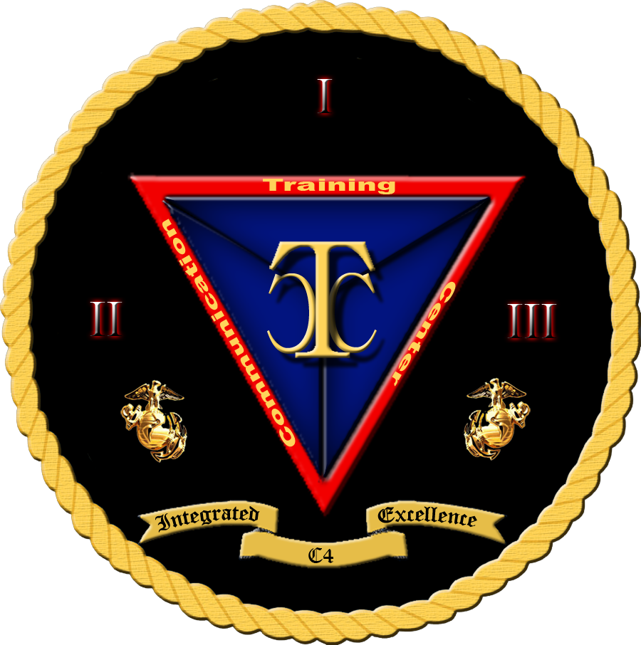

Security+
Exam SY0-601
Chapter 15
Physical Security Controls
Notes:
Gain Attention

Slide 2
Chapter 15 (Domain 2.7) Learning Objectives
Explain the importance of physical security controls.
Bollards/barricades
Access control vestibules
Badges
Alarms
Signage
Cameras
Motion recognition
Object detection
Closed-circuit television (CCTV)
Industrial camouflage
Personnel
Guards
Robot sentries
Reception
Two-person integrity/control
Locks
Biometrics
Electronic
Physical
Cable locks
USB data blocker
Lighting
Fencing
Fire suppression
Sensors
Motion detection
Noise detection
Proximity reader
Moisture detection
Cards
Temperature
Drones
Visitor logs
Faraday cages
Air gap
Screened subnet (previously known as demilitarized zone)
Protected cable distribution
Secure areas
Air gap
Vault
Safe
Hot aisle
Cold aisle
Secure data destruction
Burning
Shredding
Pulping
Pulverizing
Degaussing
Third-party solutions

Slide 3
Physical Security
Physical security is an important topic for businesses dealing with the security of networks and information systems.
Businesses are responsible for managing their risk exposure, which requires securing a combination of assets: employees, product inventory, trade secrets, and strategy information.
Environmental controls play an important role in the protection of the systems used to process information.

Slide 4
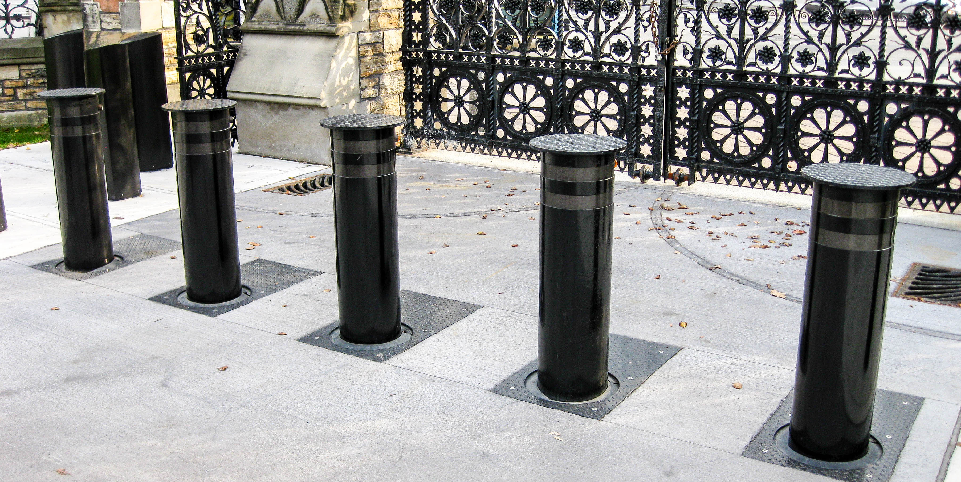
Bollards/Barricades
The primary defense against a majority of physical attacks is the barricades between the assets and a potential attacker—walls, fences, gates, and doors.
Barricades can also be used to control vehicular access to and near a building or structure. The simple post-type barricade that prevents a vehicle from passing but allows people to walk past is called a bollard.

Slide 5
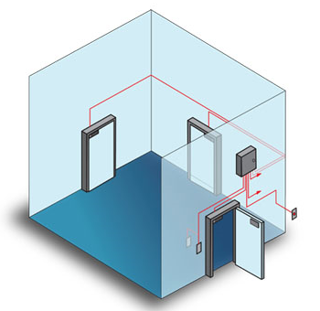
Access Control Vestibules
An access control vestibule, previously known as a mantrap, is composed of two closely spaced doors that require the user to card through one and then the other sequentially.
Mantraps make it nearly impossible to trail through a doorway undetected—if an intruder happens to catch the first door before it closes, he will be trapped in by the second door, as the second door remains locked until the first one closes and locks.

Slide 6
Badges
A badge with a picture on it can enable others to quickly determine if you are an employee or not.
Visitors are given their own badge that identifies them as a visitor.
Radio-frequency identification (RFID) uses electromagnetic fields to automatically identify and record information.
RFID tags are widely used in identification badges, replacing earlier magnetic stripe cards and making them useable with just a swipe near a reader.

Slide 7
Alarms
Physical security can involve numerous sensors, intrusion alarms, motion detectors, switches that alert to doors being opened, video and audio surveillance, and more.
When one of these systems has information that can be of use to operational personnel, an alarm is the easiest method of alerting personnel to the condition.
May be known as Intrusion Detection System IDS or Duress system.

Slide 8
Signage
Signs act as informational devices and can be used in a variety of ways to assist in physical security.
Signage can provide information as to areas that are restricted, or it can indicate where specific precautions, such as keeping doors locked, are required.
A common use of signs in high-security facilities is to delineate where visitors are allowed versus secured areas where escorts are required.
Visual security clues can assist in alerting users to the need for specific security precautions.
Visual clues as to the types of protection required can take the form of different-color name badges that signify the level of access, visual lanyards that indicate visitors, colored folders, and so forth.

Slide 9
Cameras
Cameras are an important tool for security.
Cameras enable the re-creation of scenes at a later date.

Slide 10
Motion Recognition
Motion recognition is an important technology to limit the search time and recording space associated with video images.
Infrared (IR) radiation is not visible to the human eye, but it can be used just like a light source to detect a range of things.
Motion from living creatures can be seen because of the heat signatures of their bodies.
Infrared detection is a technical means of looking for things that otherwise may not be noticed.
Infrared detectors can sense differences in temperature, which can be from a person entering a room, even if that person is not visible due to darkness. IR alarms are used extensively to monitor movement of people in areas where there should be none.

Slide 11
Object Detection
Modern surveillance video systems come with some impressive software.
Even cameras sold to homeowners can scan video for movement and detect people, cars, and other designated objects such as packages left on a porch.
The use of video software for object detection does not replace the human eye, but it significantly enhances a guard’s ability to effectively use large banks of cameras to cover a facility.
The citywide video surveillance system in London was the primary source of evidence that identified the terrorists who set off a series of bombs across the city in 2005.

Slide 12
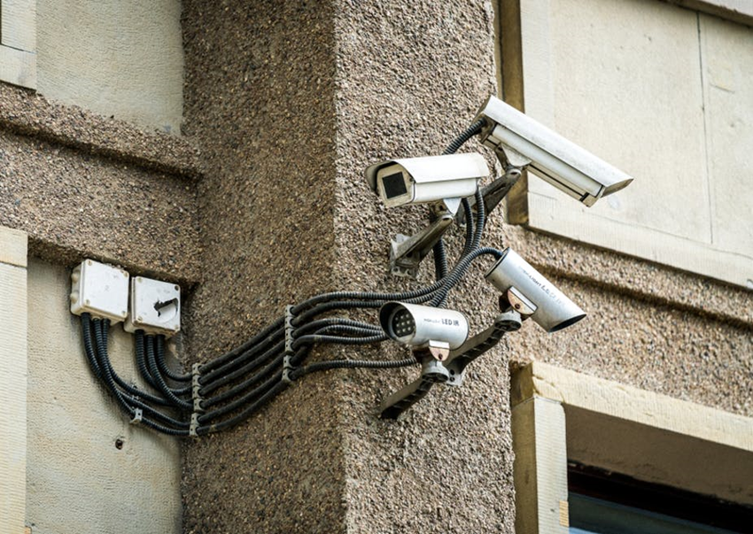
Object Detection
CCTV cameras are used to monitor a workplace for security purposes.
Digital, IP-based cameras are viewable through a web browser.

Slide 13
Closed-Circuit Television (CCTV)
IP-based CCTV cameras should be placed on their own separate network that can be accessed only by security personnel.
The same physical separation applies to any IP-based camera infrastructure.

Slide 14
Industrial Camouflage
Camouflage is the specific act of rendering an item not readily observable.
Considered by many to be a military thing, camouflage began in nature, where insects and animals have patterns making them seem to be different than they really are.
This same principle is used all the time to make things hide in plain sight.
Cell phone towers built to look like trees make them less conspicuous—and generally improve the visual surroundings.
In response to physical acts against electrical substations, many utilities have put walls around the substations, making the internal equipment no longer visible and less of a target.

Slide 15
Personnel
Physical security should be a part of a firm’s overall security program.
Physical security measures are those taken to ensure the separation of items to be protected from all forms of physical risk.
Personnel are an important part of this equation—from guards to lobby workers who act as gatekeepers for visitors and packages, people are part of the physical security system.

Slide 16
Guards
Security guards provide an excellent security measure, because guards are a visible presence with direct responsibility for security.
Guards typically monitor entrances and exits and can maintain access logs of who has entered and departed the building.
Security personnel are helpful in physically securing the machines on which information assets reside, but to get the most benefit from their presence, they must be trained to take a holistic approach to security.

Slide 17
Robot Sentries
Guard duty is by and large boring work, and although guards aren’t highly paid over time, having a number of guards can be expensive.
Robot technology has progressed to the point where robots can now perform many simple tasks, and guard duty can be one of these tasks.
Robot sentries can patrol empty buildings and using sensors can detect the presence of unauthorized people.
Robot sentries can then report the issue to a manned station that can alert the proper authorities for a response.

Slide 18
Reception
Reception areas are used as buffer zones between different areas of a facility, segmenting the building into separate regions.
Having a visitor check-in desk allows control over visitors as well as enables functions like logging visitors, managing deliveries, and providing escorts for visitors.
In lower security environments, this reception area may simply be someone at a desk, with no physical barrier. In more secure facilities, the receptionist is not only responsible for keeping logs, issuing access badges, and notifying escorts, but also controls the door everyone must go through.
In very highly controlled environments, the actual door control is done remotely from the other side of the door so that people can’t force their way past the receptionist.

Slide 19
Two-Person Integrity/Control
When there are physical tasks, such as opening the door mentioned in the previous section, having two people required to perform the task provides a means of checks and balances.
Two-person integrity/control is this principle in action: it is when two different people have to perform respective tasks that are both necessary for the action to occur.
Person 1 can initiate a process, check IDs, enter data in a log, and issue a visitor badge, while person 2 can control the door access.
This way, a failure by either person does not expose the process.

Slide 20
Locks
Many different lock types are used in and around the computer security arena.
There are types for laptops and other mobile devices, for desktops, and even servers.

Slide 21
Biometrics
Biometrics is the measurement of biological attributes or processes with the goal of identification of a party possessing those measurements.
Fingerprint
Eye (Iris vs retina)
Hand geometry
Facial recognition

Slide 22
Biometrics
During enrollment, a computer takes the image of the biological factor and reduces it to a numeric value.
When the user attempts to authenticate, his or her feature is scanned by the reader, and the computer compares the numeric value being read to the one stored in the database.
If they match, access is allowed. Since these physical factors are unique, theoretically only the actual authorized person would be allowed access.

Slide 23
Biometrics
Biometrics are not foolproof.
Some biometric measures can be duplicated to fool a sensor, and in many cases, the actual biometric is converted to a number that can also be intercepted and used in a software attack.

Slide 24
Electronic
Electronic locks are devices that impede a specific function unless a code is entered.
This code is compared to a stored secret, and if the correct code is entered, the lock engages the mechanical stop and allows the mechanism to open.
Electronic locks have an advantage in that they are not as susceptible to mechanical manipulation and bypass, yet they are still susceptible, in many cases via the mechanism that updates the secret “combination.”

Slide 25
Physical
Physical locks have been used for hundreds of years; their design has not changed much: a metal “token” is used to align pins in a mechanical device.
Physical locks have survived for years because they are low cost.
High-security locks have been designed to defeat attacks; these locks are more sophisticated than a standard home deadbolt system.
Typically found in commercial applications that require high security, these locks are made to resist picking and drilling, as well as other common attacks such as simply pounding the lock through the door.

Slide 26
Physical
Combination locks, which work via a rotating dial, are common on high-end safes and can raise the security level substantially.
In many cases, the only way to bypass one of these locks is to physically bypass the lock itself through drilling or other methods.
Additional levels of safeguard exist, such as shatter plates, which when broken engage pins that prevent the door from opening.

Slide 27
Cable Locks
Portable equipment has a principal feature of being portable.
This can also be a problem, as portable equipment—laptops, projectors, and the like—can be easily removed or stolen.
Cable locks provide a simple means of securing portable equipment to furniture or another fixture in the room where the equipment resides.
They also can be used in open areas such as conference centers or rooms where portable equipment is exposed to a wide range of visitors.

Slide 28
USB Data Blocker
USB connectors on computers offer a pathway for data to enter into the system.
Anyone who has physical access to a machine can plug in a USB device and execute code from the device.
There are a variety of ways to block USB ports or render them inoperable, but in some cases, the USB port serves a secondary function as a power source for external devices.
The USB connection has four conductors: two for power and two for data.
If you block the data conductors, you can still charge your device from a USB source without giving that device any access to the data.
When charging your phone in locations such as airports, or other unknown power sources, the use of a USB data blocker protects the phone but allows it to charge.

Slide 29
Lighting
Proper lighting is essential for physical security.
Unlit or dimly lit areas allow intruders to lurk and conduct unauthorized activities without a significant risk of observation by guards or other personnel.
External building lighting is important to ensure that unauthorized activities cannot occur without being observed and responded to.
Internal lighting is equally important because it enables more people to observe activities and see conditions that are not correct.
Windows can play an important role in assisting the observation of the premises.
Having sensitive areas well lit and open to observation through windows prevents activities that would otherwise take place in secret.
Unauthorized parties in server rooms are more likely to be detected if the servers are centrally located, surrounded in windows, and well lit.

Slide 30
Fencing
Fencing serves as a physical barrier around property.
It can serve to keep people out or in, preventing the free movement across unauthorized areas.
Fencing can be an important part of a physical security plan.
Many organizations prefer to have a perimeter fence as a physical first layer of defense.
Inside a building, fencing can be used to provide a means of restricting entry into areas where separate physical security policies apply.

Slide 31
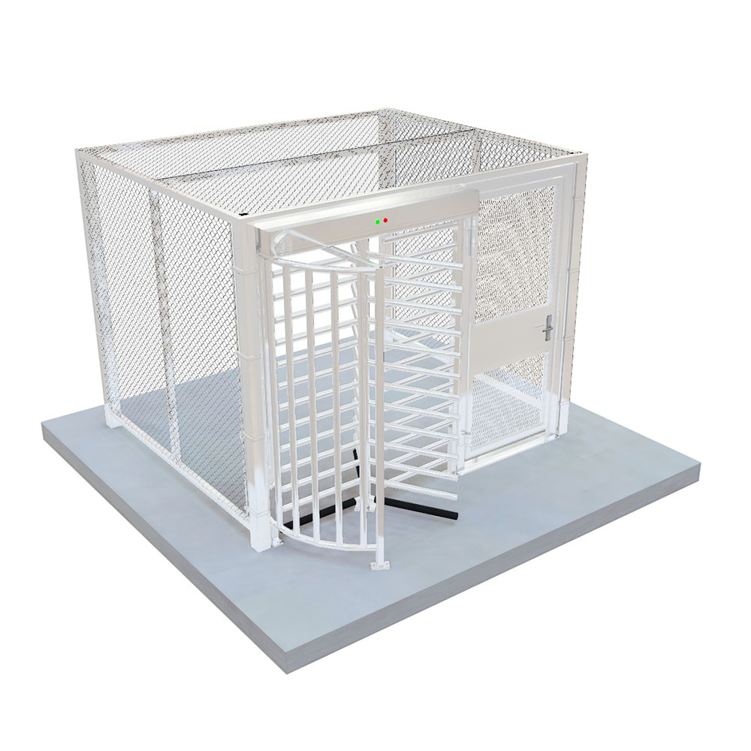
Fencing
These areas are typically called a cage, and entry/exit to the caged areas is via a gate.
The gate allows controlled access and makes it easier to monitor who and what enters and leaves the controlled area.
Gates are used for external fencing as well.
Gates offer a monitoring point for ingress and egress from a controlled area.

Slide 32
Fire Suppression
The ability to respond to a fire quickly and effectively is thus critical to the long-term success of any organization.
Fire suppression systems are designed to provide protection against the damage from a fire that spreads in a facility.
Because they are suppression systems, they don’t prevent the fire from occurring per se, but they do stop it once it begins.

Slide 33
Fire Suppression
Water-Based Fire Suppression Systems
Clean-Agent Fire Suppression Systems
CO2
FM-200; most preferred for data centers, least toxic for humans
Handheld Fire Extinguishers

Slide 34
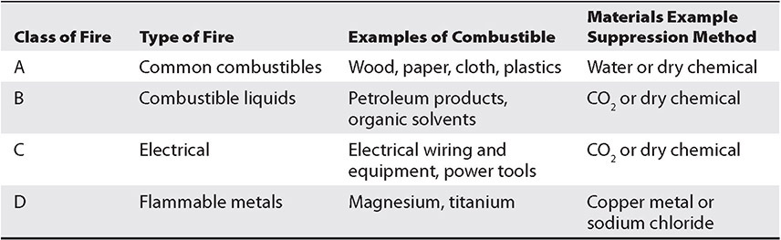
Classes of Fires

Slide 35
Fire Detection Devices
There are several different types of fire detectors.
Smoke:
Photoelectric – monitors and internal beam of light
Ionization – uses an ionization chamber and small radioactive source to detect fast-burning fires.
Heat:
Fixed-temperature
Rate-of rise (rate of increase)
Flame
Detects change in infrared energy

Slide 36
Sensors
One of the first items in the security equation is detection.
Detection of a specific signal can then be compared to a reference as to if it is allowed or not.
The sensor element provides the detection aspect to the security system, enabling decisions and resultant processes.
For instance, a motion detector that is trained to detect oncoming traffic can sense someone going the wrong way in a tunnel or controlled exit space.

Slide 37
Motion Detection
A motion detector can alert an operator to activity in an area.
Motion detectors come in a variety of types, but most are based on infrared (heat) radiation and can detect the changes of a warm body moving.
Motion detectors can be used to trigger video systems, so they do not record large amounts of “empty” activity.

Slide 38
Noise Detection
Noise detection is a sensor method that listens for specific sounds.
Ordinary things can produce different sounds, and each of these can have a specific spectral signature that can be used to hear some items while ignoring others.
Glass breakage has a specific sound, and sensors can be tuned to “hear” glass breakage and provide an alert when it occurs.
The use of sensors that target events such as this and provide the information to a central alarm panel can greatly increase the effectiveness of security personnel in monitoring a larger facility.

Slide 39
Proximity Reader
Proximity readers are sensors that provide a signal at a specified distance.
The most common application of these are card readers connected to doors: you “swipe” your card by placing it near the reader, and if the codes are correct, you are granted access.

Slide 40
Moisture Detection
Moisture detection sensors provide a remote means of monitoring everything from water leaks to humidity problems.
Water can cause damage to electronics, artwork, and many other items.
Being able to monitor moisture levels provides the security team a means of detecting the potential for damage from items such as leaking sprinklers or water leaks.

Slide 41
Cards
Many organizations rely on a badging system using either tokens or cards that can be tied to automated ID checks and logging of entry/exit.
This can provide much greater detail in tracking who is in a facility and when they have come and gone.
Tokens and cards can provide a serialized ID for each user, enabling user-specific logging.
Tokens and cards offer the same function as keys, but the system can be remotely updated to manage access in real time, and users can have their privileges revoked without a company or admin having to recover the token or card.
Smart cards, CAC, PIV, Access badges, etc.

Slide 42
Temperature
Temperature sensors do exactly what you’d think: they sense temperatures.
Part of the physical security equation is preventing damage to the infrastructure in an organization, and servers can be an important part of that infrastructure.
Server rooms are highly temperature-controlled areas, with hot and cold sides, as servers tend to generate heat, and that heat needs to be removed.
An analytical monitoring solution can then alert the appropriate personnel when certain temperature ranges are exceeded.

Slide 43
Drones
Drones are used by railroads to inspect tracks and used by electric companies to inspect power lines.
Their ability to go almost anywhere and visually inspect things is a great resource.
These offer interesting use cases for both offense and defense in cybersecurity, because they can be used to surveil physical facilities remotely, providing eyes on demand in a variety of places you might not want a person to go to and in a timeframe that can’t be met any other way.

Slide 44
Visitor Logs
Physical security visitor logs provide the same utility as computer logs for a security investigation.
They act as a record of what was observed at specific points in time. Having roving guards check in at various places across a shift via a log entry provides a record of the actual surveillance.
Logs of visitors arriving and departing, equipment received and shipped out, and so forth serve as a record of the physical happenings in a facility.

Slide 45
Faraday Cages
Electromagnetic interference (EMI) is an electrical disturbance that affects an electrical circuit.
EMI is due to either electromagnetic induction or radiation emitted from an external source, either of which can induce currents into the small circuits that make up computer systems and cause logic upsets.
A Faraday cage or Faraday shield is an enclosure of conductive material that is grounded.
Can be room-size or a small bag.

Slide 46
Air Gap
Air gap is a term used to describe the physical and logical separation of a network from all other networks.
This separation is designed to prevent unauthorized data transfers to and from the network.
The flaw in this logic is that users will move data by other means, such as a USB drive, to get their work done.
Frequently called “sneaker net,” this unauthorized bypassing of the air gap, although ostensibly for the purpose of mission accomplishment, increases system risk because it also bypasses checks, logging, and other processes important in development and deployment.

Slide 47
Screened Subnet
The concept of a screened subnet (previously known as a demilitarized zone [DMZ]) comes from military parlance where it represents an area that is not “owned” by either side.
This concept is used in networking to indicate a zone where access controls are not as strict as the inside, or as open as the outside; it’s a place of joint cooperation and controlled risk.
This same concept works in physical structures, where the lobby is like the outside world and anyone can enter, then there are common hallways where employees mingle, and finally there are special offices and server rooms where access is tightly controlled.
The common work areas are akin to the DMZ—an area of controlled risk.

Slide 48
Protected Cable Distribution
Protected distribution/protected cabling provides physical safeguards to the cabling between systems, from all physical hazards, including interception and tapping.
Known as Protected Distribution System (PDS) in the military.
Shielding cables, such as shielded twisted pair cables, are designed to prevent electromagnetic interference from affecting the signals on the wires in the cable.
The protection of entire systems is covered in the earlier section “Faraday Cages.”

Slide 49
Secure Areas
Secure areas are those areas where specific preventative measures are taken to control access both to and from.
The overall idea behind a secure area is to limit information and people flow in and out of the area, and when it is permitted it is under the proper level of control.

Slide 50
Vault
A vault is a secured area that is designed to provide a specific level of security for what is stored inside.
This can be a physical space, with specific safeguards such as walls that cannot be penetrated and doors that can be secured.
A vault is a larger item than most safes, typically room sized.

Slide 51
Safe
Safes are physical storage devices that are intended to impede unauthorized access to their protected contents.
Safes come in a wide variety of shapes, sizes, and costs.
Secure cabinets and enclosures provide system owners a place to park an asset until its use.
Most secure cabinets/enclosures do not offer all of the levels of protection that one gets with a safe, but they can be useful, especially when the volume of secure storage is large.

Slide 52
Secure Data Destruction
When data is no longer being used, whether it be on old printouts, old systems being discarded, or broken equipment, it is important to destroy the data before losing physical control over the media it is on.
An organization must concern itself not only with paper trash, but also the information stored on discarded objects such as computers.
It is critical for every organization to have a strong disposal and destruction policy and related procedures.
This section covers data destruction and media sanitization methods.

Slide 53
Secure Data Destruction
Burning
Shredding
Pulping
Pulverizing
Degaussing
Purging
Third-Party Solutions

